Slide 1

Spring LDAP
Dima Ionut Daniel

Slide 2
Contents
What is Spring LDAP?
LDAP Overview
LDAP Vendors
LDIF Format
Java LDAP Support
Spring LDAP
Spring LDAP Test
Advanced Spring LDAP
LDAP Controls
Object Directory Mapping
LDAP Transactions
LDAP Connection Pool
Conclusions
Bibliography

Slide 3

What is Spring LDAP?
Spring LDAP is a Java library for simplifying LDAP operations.
Spring LDAP provides:
transaction support, a pooling library, an Object-Directory Mapping (ODM) framework
an LDIF parsing library with Spring Batch integration
works with Spring Framework 2.0.x, 2.5.x as well as 3.0.x
based on the pattern of Spring's JdbcTemplate

Slide 4
LDAP Overview
The Lightweight Directory Access Protocol (LDAP) provides a standard protocol model for communicating with a directory.
The LDAP protocol is based on an earlier X.500 standard but is significantly simpler.
LDAP defines:
a message protocol used by directory clients and directory servers.
the information model determines the structure of information stored in the directory.
the naming model defines how information is organized and identified in the directory.
the Functional model defines the operations that can be performed on the directory.
the Security model defines how to protect information from unauthorized access.

Slide 5
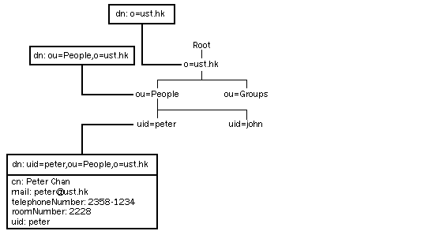
LDAP Overview (cont.)
The LDAP directory service model is based on entries.
In LDAP, directory entries are arranged in a hierarchical tree-like structure.
Each entry is uniquely identified by a distinguished name.
A distinguished name consists of a name that uniquely identifies the entry at that hierarchical level.

Slide 6
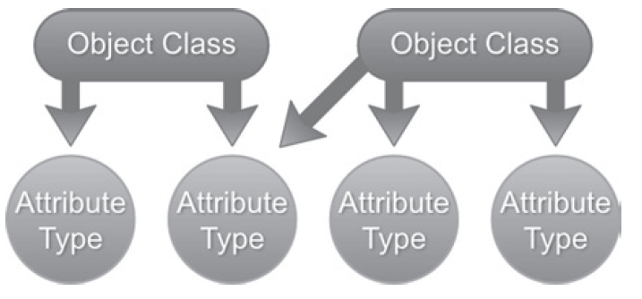
LDAP Overview (cont.)
Information Model defines:
The basic unit of information stored in LDAP is referred to as an entry.
Each entry in an LDAP directory is made up of zero or more attributes.
Attributes are simply key value pairs that hold information about the object represented by the entry.
ObjectClass: define which of the attributes are mandatory and which are optional.

Slide 7
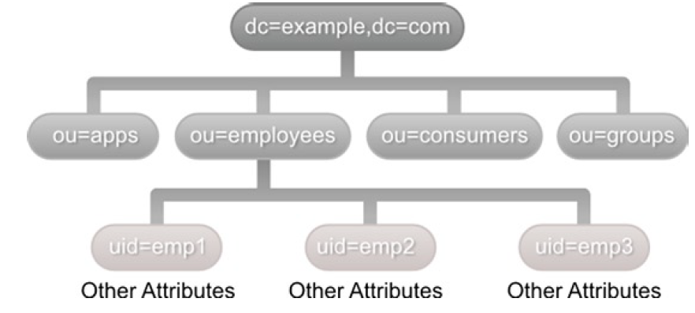
LDAP Overview (cont.)
Naming Model defines:
the organization of the entries from the directory.
the tree of entries is referred as directory information tree (DIT).
how to uniquely name and identify entries in a directory
Entries that share a common immediate parent are uniquely identified via their Relative Distinguished Name (RDN).

Slide 8
LDAP Overview (cont.)
Functional Model defines:
the access and modification operations that can be performed on the directory using LDAP protocol
operations fall in categories: query, update, and authentication.
the update operations add, modify, delete, and rename directory entries
the authentication operations are used for connecting and ending sessions between the client and LDAP server.
LDAP V3 introduced a framework for extending existing operations and adding new operations without changing the protocol itself.
Security Model defines:
- a protection mechanism for LDAP directory information from unauthorized accesses.
- which clients can access which parts of the directory and what kinds of operations
- The client must provide DN and password or an anonymous session is established

Slide 9
LDAP Vendors
Directory Name | Vendor | Open Source
Apache DS | Apache | Yes
OpenLDAP | OpenLDAP | Yes
OpenDS | Oracle(formerly Sun) | Yes
Active Directory | Microsoft | No
eDirectory | Novell | No
OpenDj | ForgeRock | Yes
Oracle Directory Server Enterprise | Oracle(formerly Sun) | No
Internet Directory | Oracle | No
Tivoli Directory | IBM | No

Slide 10
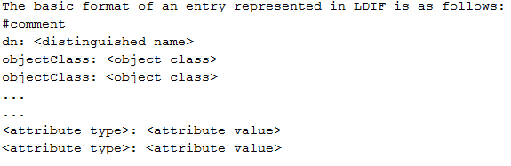
LDIF Format
The LDAP Data Interchange Format (LDIF) is a standard text-based format for representing directory content and update requests.
The LDIF format is defined in RFC 2849.
LDIF files are used to export data from one directory server and import it into another directory server.

Slide 11
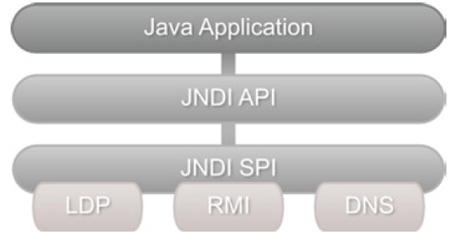
Java LDAP Support
The Java Naming and Directory Interface (JNDI) provides a standardized programming interface for accessing naming and directory services.
The JNDI architecture consists of API and a Service Provider Interface (SPI).
Vendors implement the SPI with details that deal with actual communication to their particular service/product.
JNDI has been part of the standard JDK distribution since Java version 1.3.

Slide 12

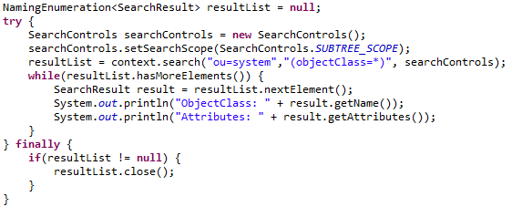
Java LDAP Support (cont.)
The Java Naming and Directory Interface (JNDI) provides a standardized programming interface for accessing the directory.
The Context interface and InitialContext class in the javax.naming package can be used for creating an initial naming context.

Slide 13
Java LDAP Support (cont.)
Using JNDI we could also add, remove, update entries.
JNDI drawbacks:
Explicit Resource Management
Plumbing Code that could be abstracted
Checked Exceptions

Slide 14
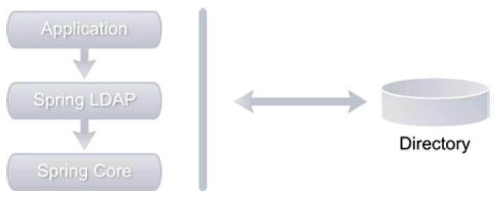
Spring LDAP
Spring LDAP provides simple, clean and comprehensive support for LDAP programming in Java.
Spring LDAP Packaging:
spring-ldap-core: LDAP framework.
spring-ldap-core-tiger: extensions.
spring-ldap-test: Contains classes and utilities that make testing easier.
spring-ldap-ldif-core: Contains classes for parsing ldif format files.
spring-ldap-ldif-batch: Contains classes necessary to integrate ldif parser with Spring Batch Framework.
spring-ldap-odm: Contains classes for enabling and creating object directory mappings.
Spring LDAP libraries have also external dependencies.

Slide 15
Spring LDAP (cont.)
The LdapTemplate is based on the Template Method design pattern.
LdapTemplate provides a number of overloaded search, lookup, bind, authenticate, and unbind methods that makes LDAP development easy.
The LdapTemplate is threadsafe and the same instance can be used by concurrent threads.
LdapTemplate operations:
search --> query directory
bind --> add a new entry
modifyAttributes --> updates an entry
unbind --> deletes an entry

Slide 16
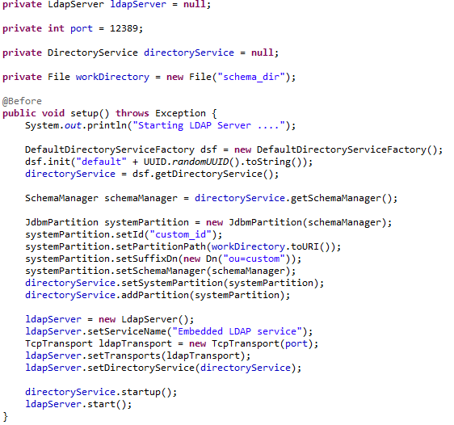
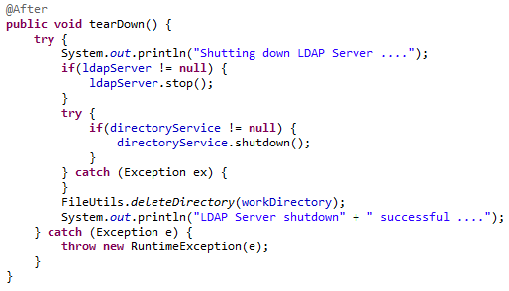
Spring LDAP Test
We can create an embedded LDAP server using the LdapServer and DirectoryService classes from Apache Ds.

Slide 17
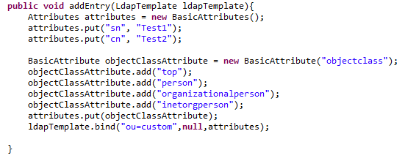
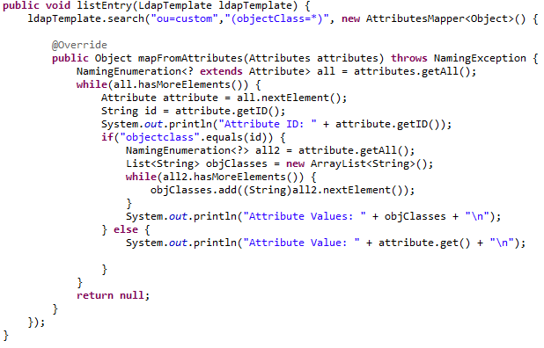
Spring LDAP Test (cont.)
We can create entries in the Embedded Directory Server using the bind method from LdapTemplate class.
We can search entries using the search method and a AttributesMapper implementation.

Slide 18
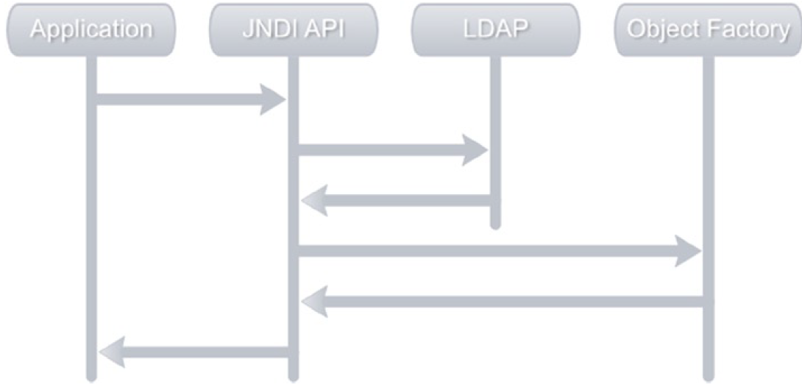
Advanced Spring LDAP
JNDI provides the notion of object factories.
An object factory transforms directory information into objects that are meaningful to the application.
The JNDI API will execute the requested operation and retrieves entries from LDAP.
These results are then passed over to the registered object factory, which transforms them into objects.
These objects are handed over to the application.

Slide 19
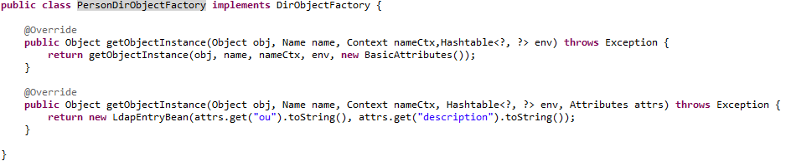
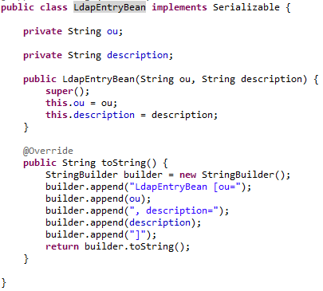
Advanced Spring LDAP (cont.)
The DirObjectFactory needs to implement 2 methods: getObjectInstace.

Slide 20
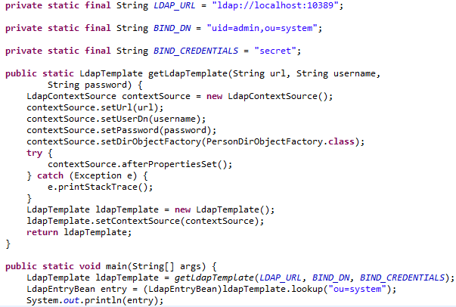
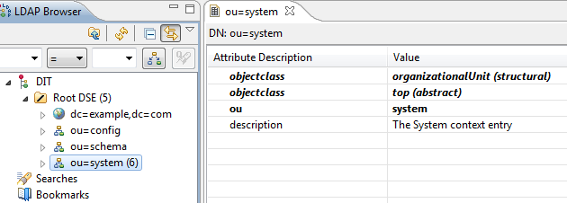
Advanced Spring LDAP (cont.)
We need to set the DirObjectFactory to the custom implementation.

Slide 21
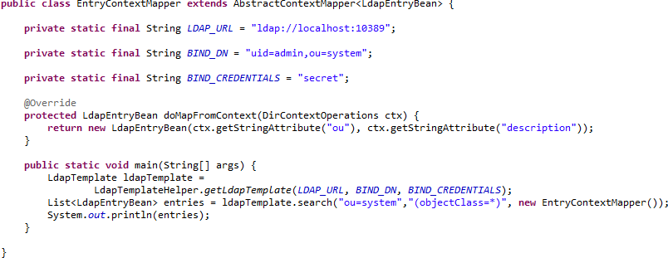
Advanced Spring LDAP (cont.)
Using Spring we can implement the AbstractContextMapper class to be used as reading data from the directory using the LdapTemplate.

Slide 22
LDAP Controls
LDAP Controls features:
provide a standardized way to modify the behavior of LDAP operations
a control can be viewed simply as a message that a client sends to an LDAP server
example: a delete subtree control can be specified on an LDAP delete operation; these controls are referred to as request controls.
The LDAP server can send controls as part of their response message indicating how the operation was processed.
example: an LDAP server may return a password policy control during a bind operation indicating that the client’s password has expired or will be expiring soon; these controls sent by the server are referred to as response controls.

Slide 23
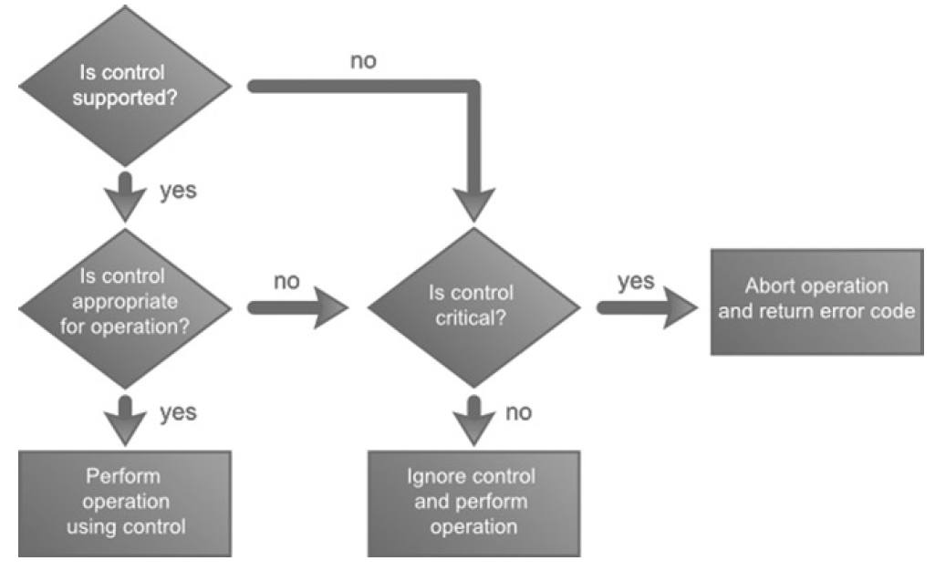
LDAP Controls (cont.)
There is no limit of the request/response controls.
The definition of an LDAP control as specified in RFC 2251.
LDAP controls contains the following information:
Object Identifier (OID) that uniquely identifies the control.
Boolean flag indicating if the control is critical or non-crical.
Optional informtion specific to the control.

Slide 24
LDAP Controls (cont.)
Control Name | OID | Description RFC
Sort Control | 1.2.840.113556.1.4.473 | Requests the server to sort the search results before sending them to client.
Paged Results Control | 1.2.840.113556.1.4.319 | Requests the server to return search results in pages consisting of specified number of entries.
Subtree Delete Control | 1.2.840.113556.1.4.805 | Requests the server delete the entry and all its descendent entries.
Virtual List View Control | 2.16.840.1.113730.3.4.9 | This is similar to Page search results but allows client request arbitrary subsets of entries.
Password Policy Control | 1.3.6.1.4.1.42.2.27.8.5.1 | Server-sent control that holds information about failed operation
Manage DSA/IT Control | 2.16.840.1.113730.3.4.2 | Requests the server to treat “ref” attribute entries (referrals) as regular LDAP entries.
Persistent Search Control | 2.16.840.1.113730.3.4.3 | Allows the client to receive notifications of changes in the LDAP server for entries that match a search criteria.

Slide 25
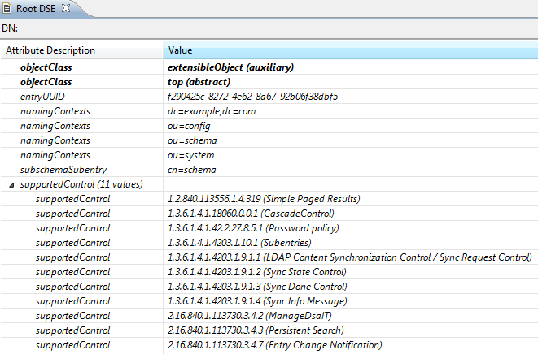
LDAP Controls (cont.)
LDAP v3 compliant server publish all the supported controls in the supportedControl attribute of the Root DSA-Specific Entry (DSE).

Slide 26
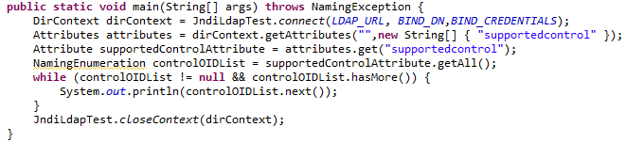
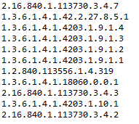
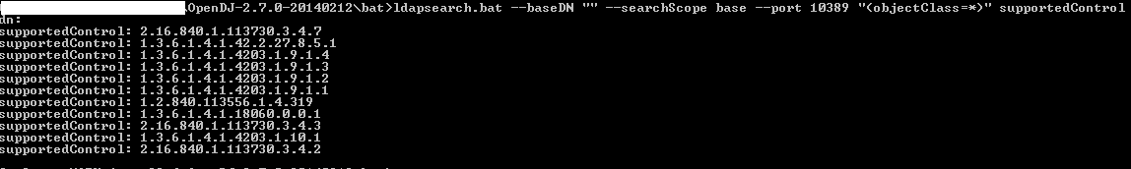
LDAP Controls (cont.)
The javax.naming.ldap package in the JNDI API contains support for LDAP V3-specific features such as controls and extended operations.
While controls modify or augment the behavior of existing operations, extended operations allow additional operations to be defined.
The javax.naming.ldap.Control interface provides abstraction for both request and response controls.

Slide 27
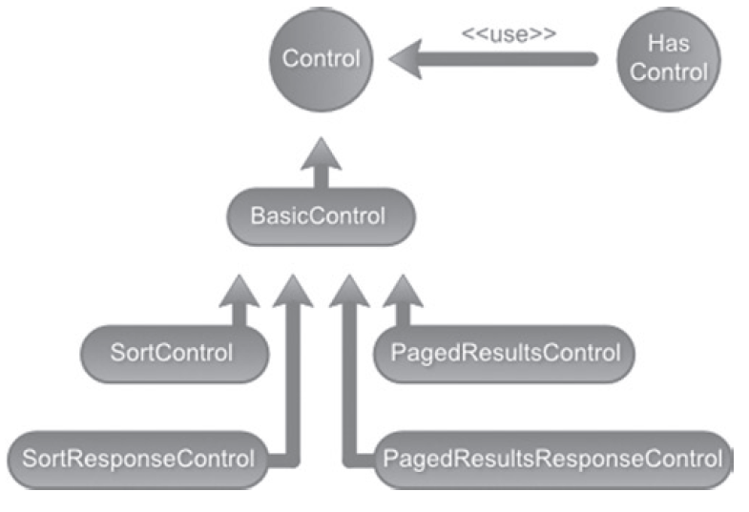
LDAP Controls (cont.)
The javax.naming.ldap.Control interface provides abstraction for both request and response controls. Several implementations of this interface, such as SortControl and PagedResultsControl, are provided as part of the JDK.

Slide 28
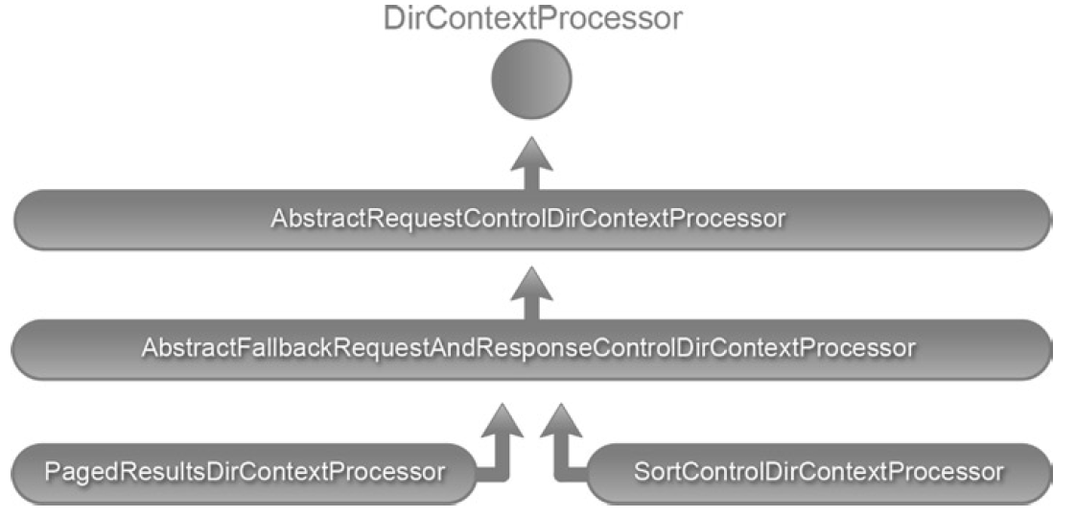
LDAP Controls (cont.)
Spring LDAP provides a directory context processor that automates the augmentation of LDAP controls to a context.
A implementation of the DirContextProcessor interface is passed to LdapTemplate search methods.
The preProcess method gets called before a search is performed.
The postProcess method will be called after the search execution.

Slide 29
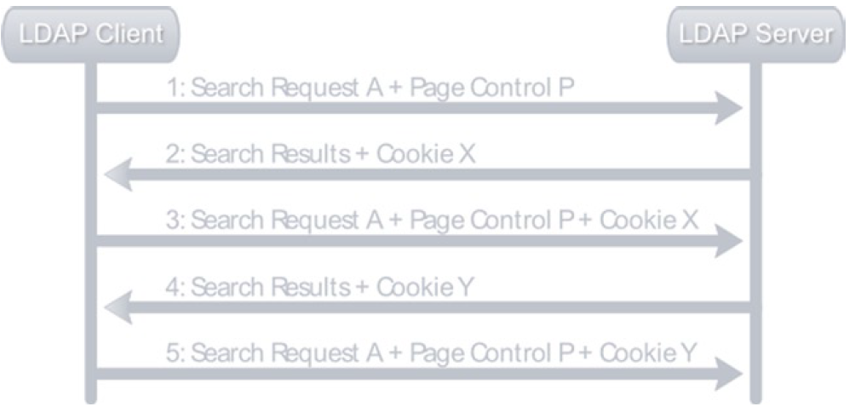
LDAP Controls (cont.)
LDAP servers often use the sizeLimit directive to restrict the number of results for a search operation.
If a search produces more results than the specified sizeLimit, an exception javax.naming.SizeLimitExceededException is thrown.
Paged Search Controls is described in RFC 2696:
allows LDAP clients to control the rate at which the results of an LDAP search operation are returned.
the LDAP server will return the results in chunks
the paged results control is highly useful when dealing with large directories or building search applications with paging capabilities.

Slide 30
Object Directory Mapping
Spring LDAP provides an Object-Directory Mapping (ODM) framework that bridges the gap between the object and directory models.
ODM is similar to Object-Relational Mapping (ORM).
Spring LDAP ODM features:
caching of LDAP entries.
ODM metadata is stored via class-level annotations.
no need for XML configuration.
Loading of objects is done via DN lookups.
OdmManager provides generic search and CRUD operations; acts as a mediator and transforms data between LDAP entries and Java objects.
Ldap annotations: @Entry, @Id, @Attribute, @DnAttribute, @Transient.

Slide 31
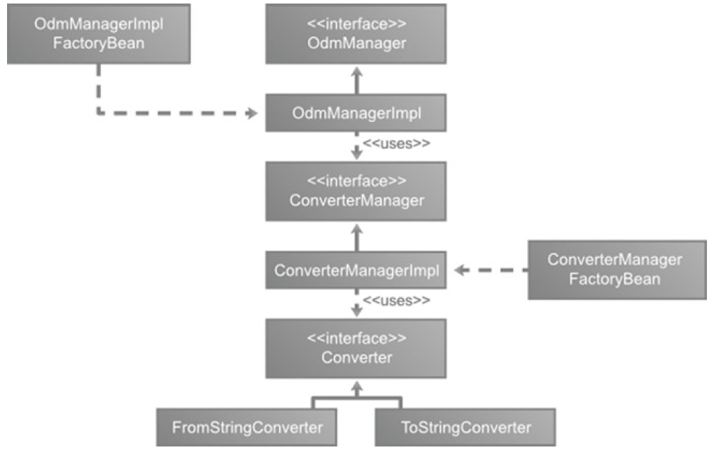
Object Directory Mapping (cont.)
The Spring LDAP ODM is available under the org.springframework.ldap.odm package and its subpackages.

Slide 32
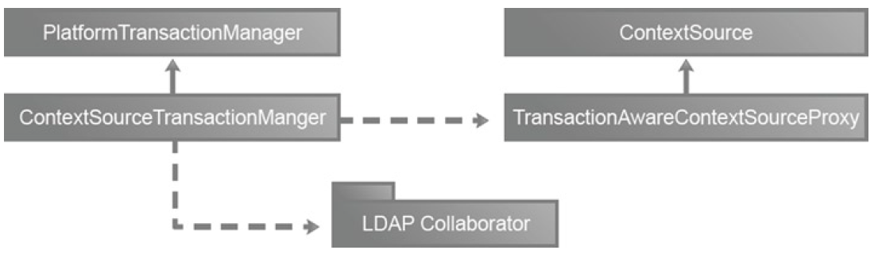
LDAP Transactions
Transactions ACID properties:
atomicity: transaction executes completely.
consistency: transaction leaves the system in a consistent state after its completion.
isolation: transaction executes independent of other parallel transactions
durability: results of a committed transaction never get lost due to a failure.
Trransactions are not part of the LDAP specification.
Servers such as IBM Tivoli Directory Server and ApacheDS provide transaction support.
The RFC 5805 attempts to standardize transactions in LDAP and is currently in experimental state.
Sample LDAP controls:
the Begin transaction (OID 1.3.18.0.2.12.5) extended control
end transaction (OID 1.3.18.0.2.12.6) extended control

Slide 33

LDAP Connection Pool
Without connection pooling, each request to LDAP directory causes a new connection to be created and then released when the connection is no longer required.
Creating a new connection is resource-intensive and this overhead can have adverse effects on performance.
With connection pooling, connections are stored in pool after they are created and are recycled for subsequent client requests.
Connections in a pool can be in following states:
In Use: The connection is open and currently in use.
Idle: The connection is open and available for reuse.
Closed: The connection is no longer available for use.

Slide 34
LDAP Connection Pool (cont.)
JNDI provides basic support for connection pooling via the "com.sun.jndi.ldap.connect.pool" environment property.
Creating a directory context with this property set to true will indicate that connection pooling needs will be turned on.
When close() method from Context is called the connection is returned in the pool.
In order to turn on the connection pool feature to LdapContextSource the pooled property needs to be set to true; Spring LDAP utilizes the Jakarta Commons Pool library for its underlying pooling implementation.
Spring LDAP can validate pooled connections before they are used; DirContextValidator needs to be implemented.
DefaultDirContextValidator represents a basic implementation of DirContextValidator.

Slide 35
Conclusions
Spring LDAP doesn’t replace the JNDI, but rather wraps it and extends it to simplify LDAP programming.
Pros:
Easy to use
Documented
Can be used in Spring xml application context

Slide 36

Bibliography
Apress – Practical Spring LDAP

